Slide 1
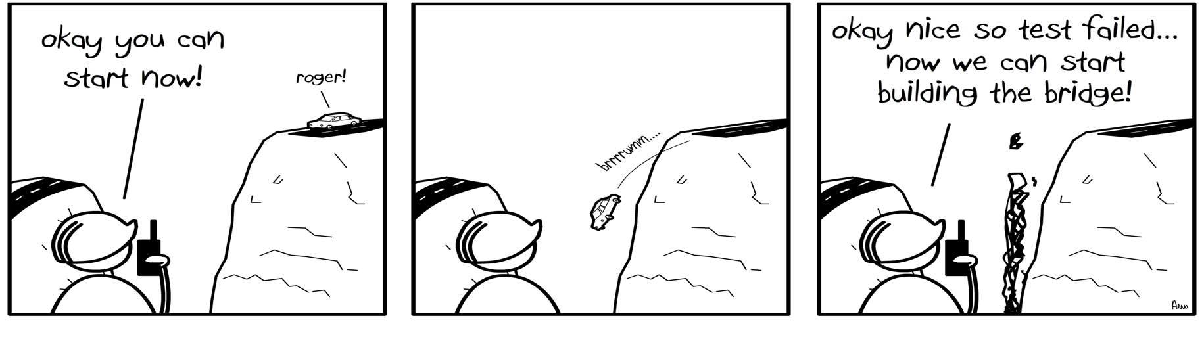
TDD !

Slide 2
Why code sucks?
Notes:
Ask people why code sucks? Write them down

Slide 3
And how to make it suck less?
Notes:
What people want to make code better

Slide 4
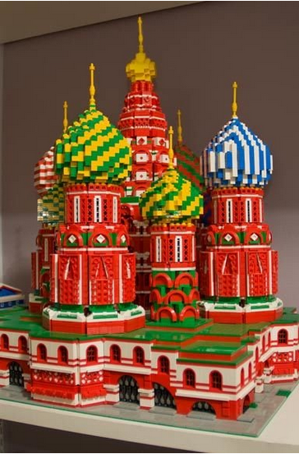
Notes:
Task : changing dome from gold to white

Slide 5
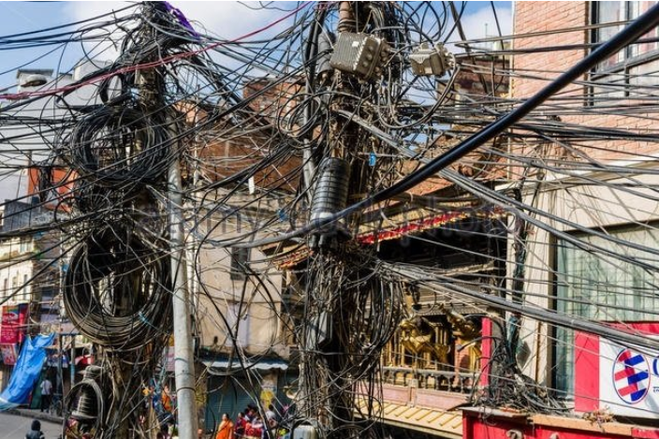
Notes:
Task : Changing the red wire

Slide 6
Vs

Slide 7
Lets talk about TDD…

Slide 8
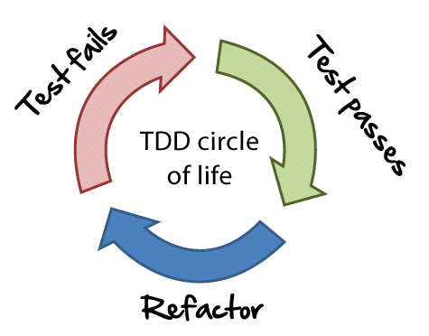
?
Notes:
What is TDD?
Writing tests before code
“Test-driven development (TDD) is a software development technique that uses short development iterations based on pre-written test cases that define desired improvements or new functions. Each iteration produces code necessary to pass that iteration's tests. Finally, the programmer or team refactors the code to accommodate changes.

Slide 9
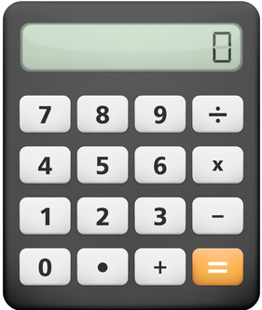

Slide 10
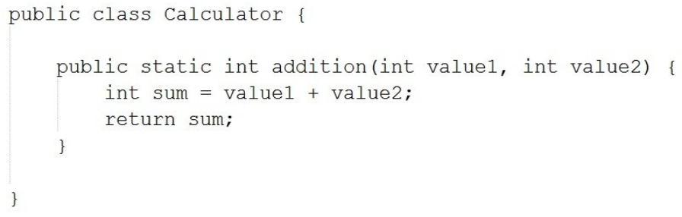

Slide 11
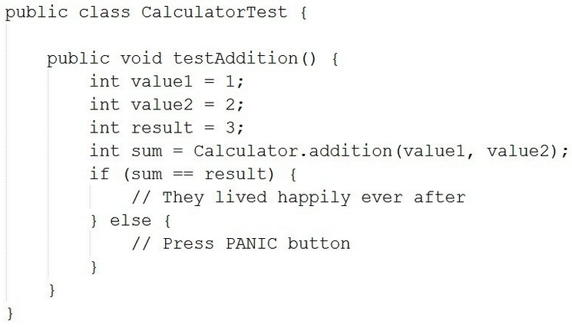

Slide 12
Expectation Vs Reality !!

Slide 13
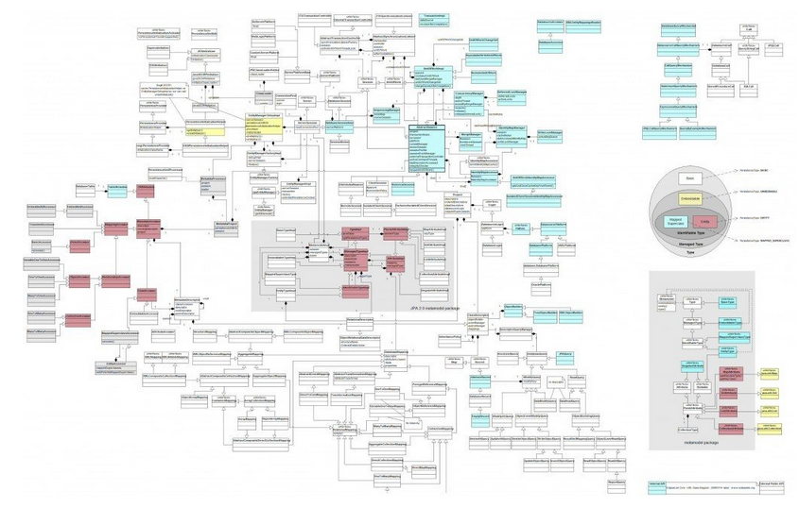
Notes:
In reality systems are much more complex

Slide 14
Why TDD ?

Slide 15
Clean code that works!

Slide 16
“Clean code is a code that is written by someone who cares...”
- Michael Feathers

Slide 17
How TDD helps?
Notes:
Key and lock tight coupling
Cohesion refers to what the class (or module) can do. Low cohesion would mean that the class does a great variety of actions - it is broad, unfocused on what it should do. High cohesion means that the class is focused on what it should be doing, i.e. only methods relating to the intention of the class.
As for coupling, it refers to how related or dependent two classes/modules are toward each other. For low coupled classes, changing something major in one class should not affect the other. High coupling would make it difficult to change and maintain your code; since classes are closely knit together, making a change could require an entire system revamp.

Slide 18
Test tells you..
If code is working
Is it loosely coupled
Is it simple/complex
Notes:
Key and lock tight coupling
Cohesion refers to what the class (or module) can do. Low cohesion would mean that the class does a great variety of actions - it is broad, unfocused on what it should do. High cohesion means that the class is focused on what it should be doing, i.e. only methods relating to the intention of the class.
As for coupling, it refers to how related or dependent two classes/modules are toward each other. For low coupled classes, changing something major in one class should not affect the other. High coupling would make it difficult to change and maintain your code; since classes are closely knit together, making a change could require an entire system revamp.

Slide 19
Which means..
Building right thing
Easy to change
Easy to understand
Notes:
Key and lock tight coupling
Cohesion refers to what the class (or module) can do. Low cohesion would mean that the class does a great variety of actions - it is broad, unfocused on what it should do. High cohesion means that the class is focused on what it should be doing, i.e. only methods relating to the intention of the class.
As for coupling, it refers to how related or dependent two classes/modules are toward each other. For low coupled classes, changing something major in one class should not affect the other. High coupling would make it difficult to change and maintain your code; since classes are closely knit together, making a change could require an entire system revamp.

Slide 20
Building working system
Vs
Building working & testable components

Slide 21
Vs

Slide 22
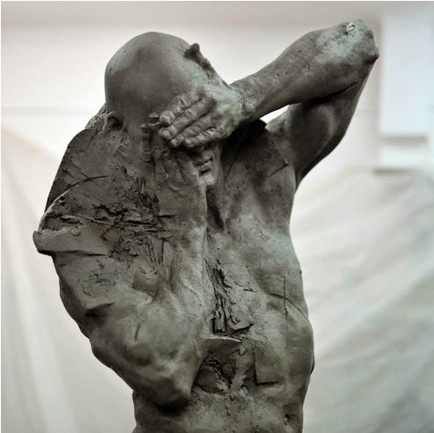

Slide 23
Benefits of TDD?

Slide 24
Before Test-Driven

Slide 25
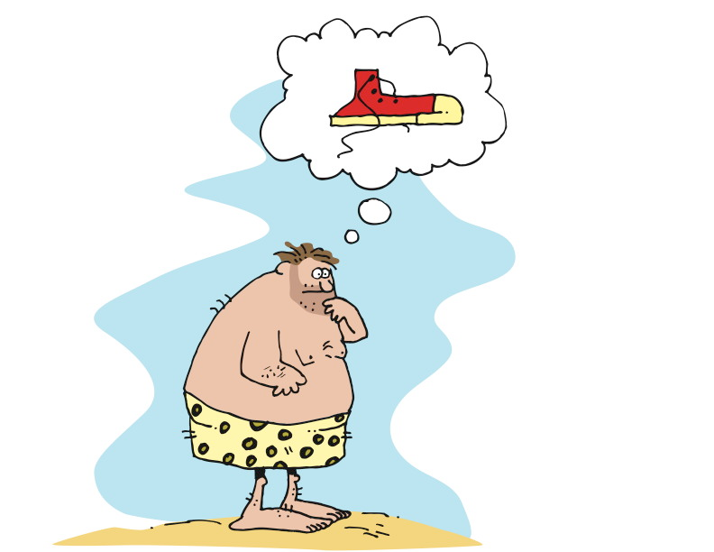
An Idea
Notes:
Test-Driven Design / Test-First
“Test-driven development (TDD) is a software development technique that uses short development iterations based on pre-written test cases that define desired improvements or new functions. Each iteration produces code necessary to pass that iteration's tests. Finally, the programmer or team refactors the code to accommodate changes. A key TDD concept is that preparing tests before coding facilitates rapid feedback changes. Note that test-driven development is a software design method, not merely a method of testing.”
http://en.wikipedia.org/wiki/Test-driven_development
First figure out how to determine if you’ve succeeded, then build it
Concept: Waterfall version
* Frames:
Barefoot, primitive man with idea of shoes
Man tells someone else what he’s thinking
Other man constructing something in his cave
Other man delivers something that is outrageous, and loosely like shoes
Original man wearing (things), looking unhappy and confused
Concept: making shoes – they must fit the foot
* Frames:
Frame: barefoot, primitive man with idea of shoes – walking over stones, through streams, kicking a (coconut),…
Frame:
Text: TEST FAILS
Image: man stepping on rocks, painful
Frame:
Text: DEVELOP
Image: man attaching cords/strips of leather to a piece of bark
Frame:
Text: TEST PASS
Image: man with piece of bark strapped to foot, satisfied look
Frame:
Text: REFACTOR
Image: man cuts bark to shape of foot
Frame:
Text: TEST FAILS
Image: man walking under falling pebbles, pebbles hitting top of foot, man looking pained

Slide 26
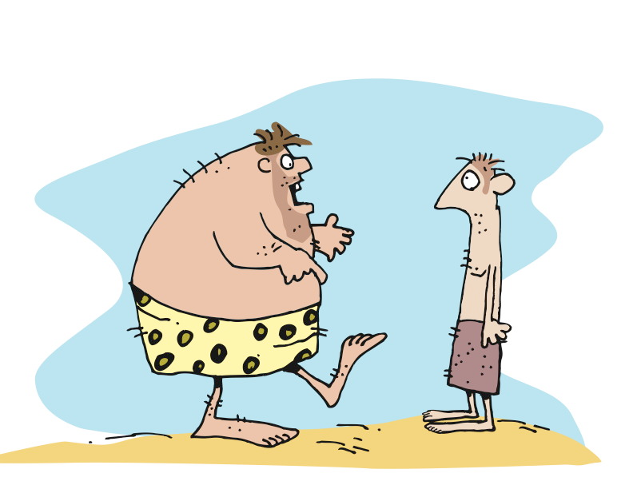
Requirements
Notes:
Test-Driven Design / Test-First
“Test-driven development (TDD) is a software development technique that uses short development iterations based on pre-written test cases that define desired improvements or new functions. Each iteration produces code necessary to pass that iteration's tests. Finally, the programmer or team refactors the code to accommodate changes. A key TDD concept is that preparing tests before coding facilitates rapid feedback changes. Note that test-driven development is a software design method, not merely a method of testing.”
http://en.wikipedia.org/wiki/Test-driven_development
First figure out how to determine if you’ve succeeded, then build it
Concept: Waterfall version
* Frames:
Barefoot, primitive man with idea of shoes
Man tells someone else what he’s thinking
Other man constructing something in his cave
Other man delivers something that is outrageous, and loosely like shoes
Original man wearing (things), looking unhappy and confused
Concept: making shoes – they must fit the foot
* Frames:
Frame: barefoot, primitive man with idea of shoes – walking over stones, through streams, kicking a (coconut),…
Frame:
Text: TEST FAILS
Image: man stepping on rocks, painful
Frame:
Text: DEVELOP
Image: man attaching cords/strips of leather to a piece of bark
Frame:
Text: TEST PASS
Image: man with piece of bark strapped to foot, satisfied look
Frame:
Text: REFACTOR
Image: man cuts bark to shape of foot
Frame:
Text: TEST FAILS
Image: man walking under falling pebbles, pebbles hitting top of foot, man looking pained

Slide 27
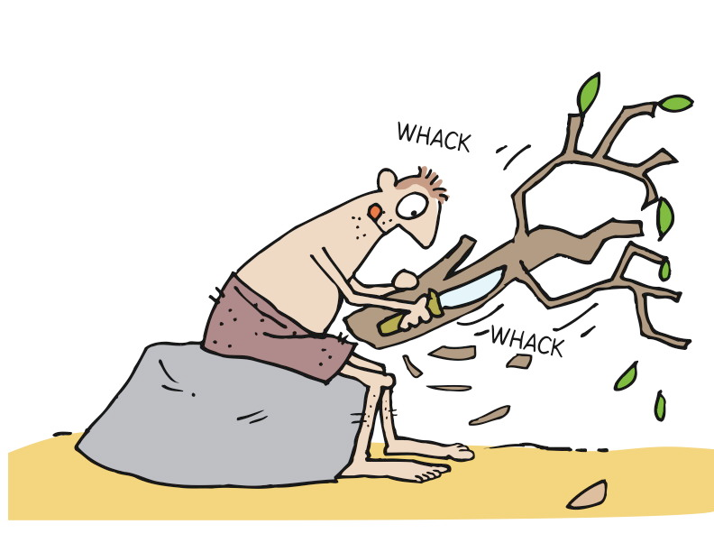
Development
Notes:
Test-Driven Design / Test-First
“Test-driven development (TDD) is a software development technique that uses short development iterations based on pre-written test cases that define desired improvements or new functions. Each iteration produces code necessary to pass that iteration's tests. Finally, the programmer or team refactors the code to accommodate changes. A key TDD concept is that preparing tests before coding facilitates rapid feedback changes. Note that test-driven development is a software design method, not merely a method of testing.”
http://en.wikipedia.org/wiki/Test-driven_development
First figure out how to determine if you’ve succeeded, then build it
Concept: Waterfall version
* Frames:
Barefoot, primitive man with idea of shoes
Man tells someone else what he’s thinking
Other man constructing something in his cave
Other man delivers something that is outrageous, and loosely like shoes
Original man wearing (things), looking unhappy and confused
Concept: making shoes – they must fit the foot
* Frames:
Frame: barefoot, primitive man with idea of shoes – walking over stones, through streams, kicking a (coconut),…
Frame:
Text: TEST FAILS
Image: man stepping on rocks, painful
Frame:
Text: DEVELOP
Image: man attaching cords/strips of leather to a piece of bark
Frame:
Text: TEST PASS
Image: man with piece of bark strapped to foot, satisfied look
Frame:
Text: REFACTOR
Image: man cuts bark to shape of foot
Frame:
Text: TEST FAILS
Image: man walking under falling pebbles, pebbles hitting top of foot, man looking pained

Slide 28
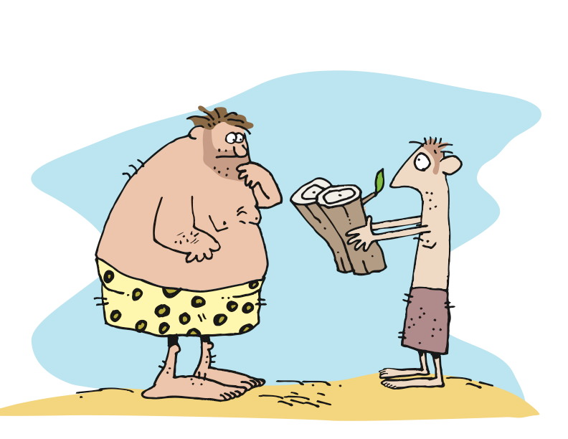
Ready for testing
Notes:
Test-Driven Design / Test-First
“Test-driven development (TDD) is a software development technique that uses short development iterations based on pre-written test cases that define desired improvements or new functions. Each iteration produces code necessary to pass that iteration's tests. Finally, the programmer or team refactors the code to accommodate changes. A key TDD concept is that preparing tests before coding facilitates rapid feedback changes. Note that test-driven development is a software design method, not merely a method of testing.”
http://en.wikipedia.org/wiki/Test-driven_development
First figure out how to determine if you’ve succeeded, then build it
Concept: Waterfall version
* Frames:
Barefoot, primitive man with idea of shoes
Man tells someone else what he’s thinking
Other man constructing something in his cave
Other man delivers something that is outrageous, and loosely like shoes
Original man wearing (things), looking unhappy and confused
Concept: making shoes – they must fit the foot
* Frames:
Frame: barefoot, primitive man with idea of shoes – walking over stones, through streams, kicking a (coconut),…
Frame:
Text: TEST FAILS
Image: man stepping on rocks, painful
Frame:
Text: DEVELOP
Image: man attaching cords/strips of leather to a piece of bark
Frame:
Text: TEST PASS
Image: man with piece of bark strapped to foot, satisfied look
Frame:
Text: REFACTOR
Image: man cuts bark to shape of foot
Frame:
Text: TEST FAILS
Image: man walking under falling pebbles, pebbles hitting top of foot, man looking pained

Slide 29
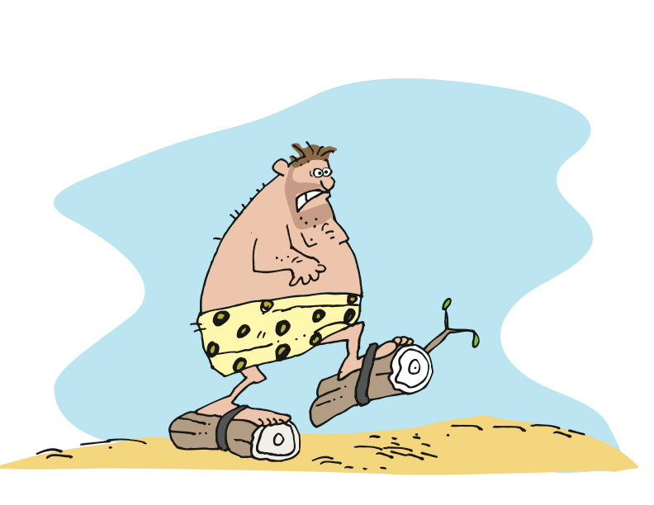
User Acceptance Testing
Notes:
Test-Driven Design / Test-First
“Test-driven development (TDD) is a software development technique that uses short development iterations based on pre-written test cases that define desired improvements or new functions. Each iteration produces code necessary to pass that iteration's tests. Finally, the programmer or team refactors the code to accommodate changes. A key TDD concept is that preparing tests before coding facilitates rapid feedback changes. Note that test-driven development is a software design method, not merely a method of testing.”
http://en.wikipedia.org/wiki/Test-driven_development
First figure out how to determine if you’ve succeeded, then build it
Concept: Waterfall version
* Frames:
Barefoot, primitive man with idea of shoes
Man tells someone else what he’s thinking
Other man constructing something in his cave
Other man delivers something that is outrageous, and loosely like shoes
Original man wearing (things), looking unhappy and confused
Concept: making shoes – they must fit the foot
* Frames:
Frame: barefoot, primitive man with idea of shoes – walking over stones, through streams, kicking a (coconut),…
Frame:
Text: TEST FAILS
Image: man stepping on rocks, painful
Frame:
Text: DEVELOP
Image: man attaching cords/strips of leather to a piece of bark
Frame:
Text: TEST PASS
Image: man with piece of bark strapped to foot, satisfied look
Frame:
Text: REFACTOR
Image: man cuts bark to shape of foot
Frame:
Text: TEST FAILS
Image: man walking under falling pebbles, pebbles hitting top of foot, man looking pained

Slide 30
Following Test-Driven Development

Slide 31
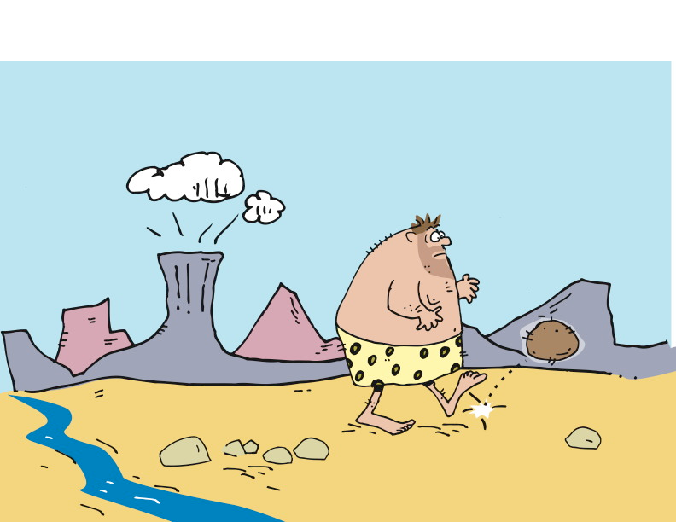
A User Story
Notes:
Test-Driven Design / Test-First
“Test-driven development (TDD) is a software development technique that uses short development iterations based on pre-written test cases that define desired improvements or new functions. Each iteration produces code necessary to pass that iteration's tests. Finally, the programmer or team refactors the code to accommodate changes. A key TDD concept is that preparing tests before coding facilitates rapid feedback changes. Note that test-driven development is a software design method, not merely a method of testing.”
http://en.wikipedia.org/wiki/Test-driven_development
First figure out how to determine if you’ve succeeded, then build it
Concept: Waterfall version
* Frames:
Barefoot, primitive man with idea of shoes
Man tells someone else what he’s thinking
Other man constructing something in his cave
Other man delivers something that is outrageous, and loosely like shoes
Original man wearing (things), looking unhappy and confused
Concept: making shoes – they must fit the foot
* Frames:
Frame: barefoot, primitive man with idea of shoes – walking over stones, through streams, kicking a (coconut),…
Frame:
Text: TEST FAILS
Image: man stepping on rocks, painful
Frame:
Text: DEVELOP
Image: man attaching cords/strips of leather to a piece of bark
Frame:
Text: TEST PASS
Image: man with piece of bark strapped to foot, satisfied look
Frame:
Text: REFACTOR
Image: man cuts bark to shape of foot
Frame:
Text: TEST FAILS
Image: man walking under falling pebbles, pebbles hitting top of foot, man looking pained

Slide 32
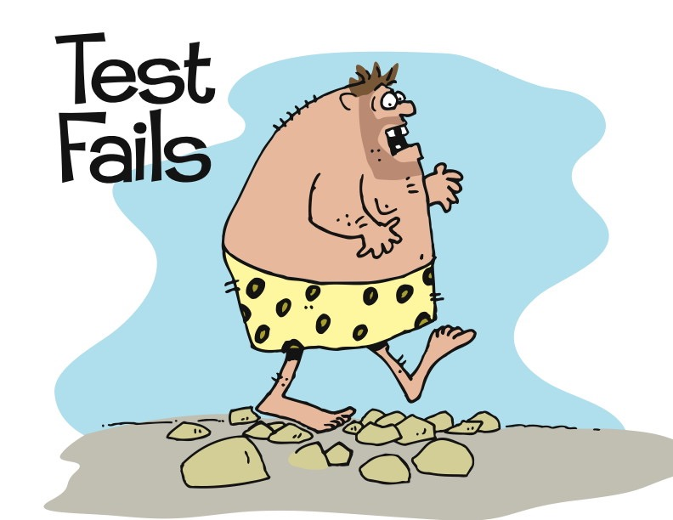
Notes:
Test-Driven Design / Test-First
“Test-driven development (TDD) is a software development technique that uses short development iterations based on pre-written test cases that define desired improvements or new functions. Each iteration produces code necessary to pass that iteration's tests. Finally, the programmer or team refactors the code to accommodate changes. A key TDD concept is that preparing tests before coding facilitates rapid feedback changes. Note that test-driven development is a software design method, not merely a method of testing.”
http://en.wikipedia.org/wiki/Test-driven_development
First figure out how to determine if you’ve succeeded, then build it
Concept: Waterfall version
* Frames:
Barefoot, primitive man with idea of shoes
Man tells someone else what he’s thinking
Other man constructing something in his cave
Other man delivers something that is outrageous, and loosely like shoes
Original man wearing (things), looking unhappy and confused
Concept: making shoes – they must fit the foot
* Frames:
Frame: barefoot, primitive man with idea of shoes – walking over stones, through streams, kicking a (coconut),…
Frame:
Text: TEST FAILS
Image: man stepping on rocks, painful
Frame:
Text: DEVELOP
Image: man attaching cords/strips of leather to a piece of bark
Frame:
Text: TEST PASS
Image: man with piece of bark strapped to foot, satisfied look
Frame:
Text: REFACTOR
Image: man cuts bark to shape of foot
Frame:
Text: TEST FAILS
Image: man walking under falling pebbles, pebbles hitting top of foot, man looking pained

Slide 33
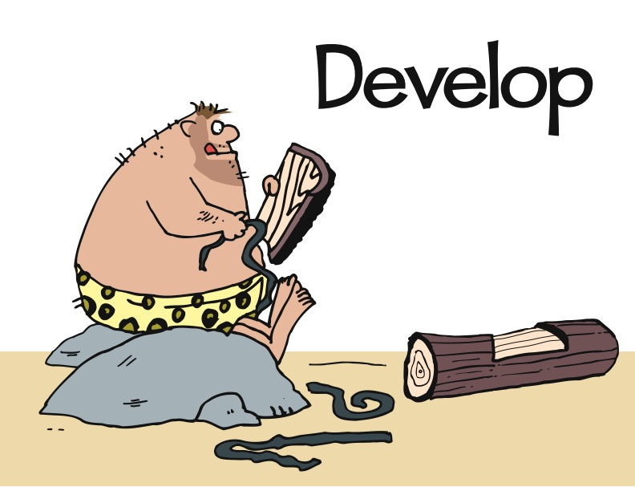
Notes:
Test-Driven Design / Test-First
“Test-driven development (TDD) is a software development technique that uses short development iterations based on pre-written test cases that define desired improvements or new functions. Each iteration produces code necessary to pass that iteration's tests. Finally, the programmer or team refactors the code to accommodate changes. A key TDD concept is that preparing tests before coding facilitates rapid feedback changes. Note that test-driven development is a software design method, not merely a method of testing.”
http://en.wikipedia.org/wiki/Test-driven_development
First figure out how to determine if you’ve succeeded, then build it
Concept: Waterfall version
* Frames:
Barefoot, primitive man with idea of shoes
Man tells someone else what he’s thinking
Other man constructing something in his cave
Other man delivers something that is outrageous, and loosely like shoes
Original man wearing (things), looking unhappy and confused
Concept: making shoes – they must fit the foot
* Frames:
Frame: barefoot, primitive man with idea of shoes – walking over stones, through streams, kicking a (coconut),…
Frame:
Text: TEST FAILS
Image: man stepping on rocks, painful
Frame:
Text: DEVELOP
Image: man attaching cords/strips of leather to a piece of bark
Frame:
Text: TEST PASS
Image: man with piece of bark strapped to foot, satisfied look
Frame:
Text: REFACTOR
Image: man cuts bark to shape of foot
Frame:
Text: TEST FAILS
Image: man walking under falling pebbles, pebbles hitting top of foot, man looking pained

Slide 34
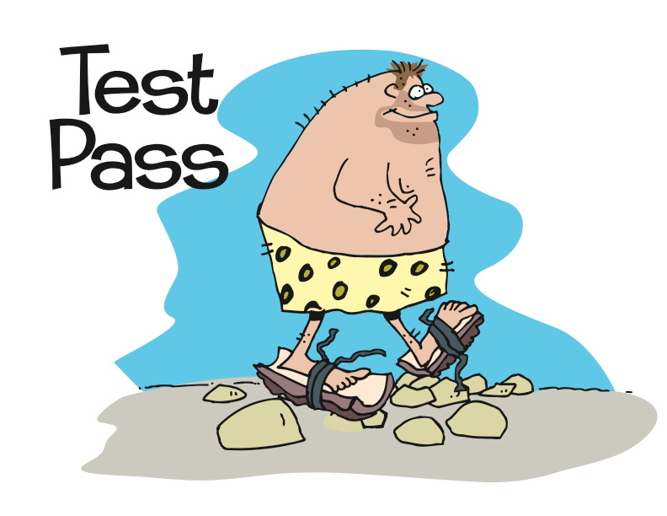
Notes:
Test-Driven Design / Test-First
“Test-driven development (TDD) is a software development technique that uses short development iterations based on pre-written test cases that define desired improvements or new functions. Each iteration produces code necessary to pass that iteration's tests. Finally, the programmer or team refactors the code to accommodate changes. A key TDD concept is that preparing tests before coding facilitates rapid feedback changes. Note that test-driven development is a software design method, not merely a method of testing.”
http://en.wikipedia.org/wiki/Test-driven_development
First figure out how to determine if you’ve succeeded, then build it
Concept: Waterfall version
* Frames:
Barefoot, primitive man with idea of shoes
Man tells someone else what he’s thinking
Other man constructing something in his cave
Other man delivers something that is outrageous, and loosely like shoes
Original man wearing (things), looking unhappy and confused
Concept: making shoes – they must fit the foot
* Frames:
Frame: barefoot, primitive man with idea of shoes – walking over stones, through streams, kicking a (coconut),…
Frame:
Text: TEST FAILS
Image: man stepping on rocks, painful
Frame:
Text: DEVELOP
Image: man attaching cords/strips of leather to a piece of bark
Frame:
Text: TEST PASS
Image: man with piece of bark strapped to foot, satisfied look
Frame:
Text: REFACTOR
Image: man cuts bark to shape of foot
Frame:
Text: TEST FAILS
Image: man walking under falling pebbles, pebbles hitting top of foot, man looking pained

Slide 35
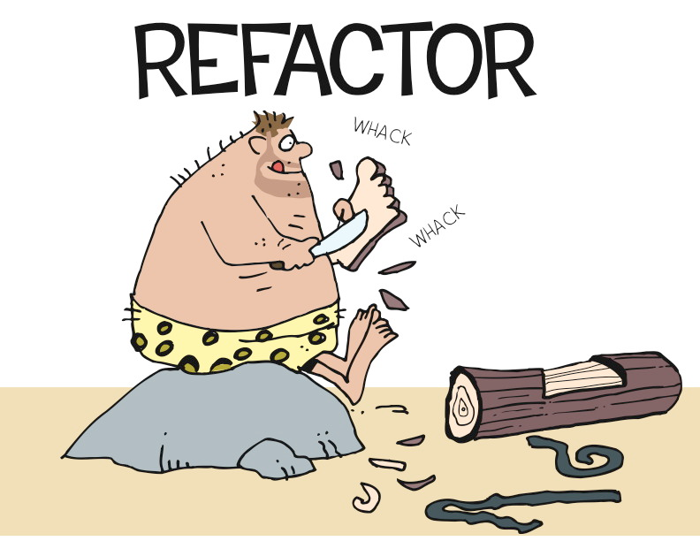
Notes:
Test-Driven Design / Test-First
“Test-driven development (TDD) is a software development technique that uses short development iterations based on pre-written test cases that define desired improvements or new functions. Each iteration produces code necessary to pass that iteration's tests. Finally, the programmer or team refactors the code to accommodate changes. A key TDD concept is that preparing tests before coding facilitates rapid feedback changes. Note that test-driven development is a software design method, not merely a method of testing.”
http://en.wikipedia.org/wiki/Test-driven_development
First figure out how to determine if you’ve succeeded, then build it
Concept: Waterfall version
* Frames:
Barefoot, primitive man with idea of shoes
Man tells someone else what he’s thinking
Other man constructing something in his cave
Other man delivers something that is outrageous, and loosely like shoes
Original man wearing (things), looking unhappy and confused
Concept: making shoes – they must fit the foot
* Frames:
Frame: barefoot, primitive man with idea of shoes – walking over stones, through streams, kicking a (coconut),…
Frame:
Text: TEST FAILS
Image: man stepping on rocks, painful
Frame:
Text: DEVELOP
Image: man attaching cords/strips of leather to a piece of bark
Frame:
Text: TEST PASS
Image: man with piece of bark strapped to foot, satisfied look
Frame:
Text: REFACTOR
Image: man cuts bark to shape of foot
Frame:
Text: TEST FAILS
Image: man walking under falling pebbles, pebbles hitting top of foot, man looking pained

Slide 36
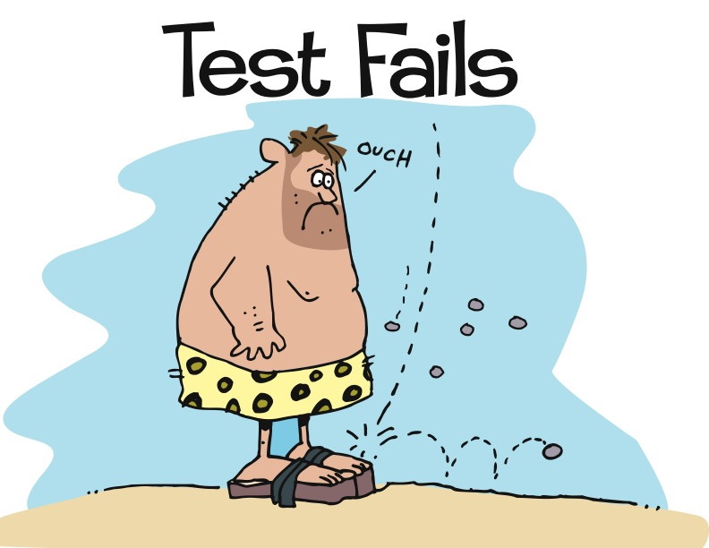
Notes:
Test-Driven Design / Test-First
“Test-driven development (TDD) is a software development technique that uses short development iterations based on pre-written test cases that define desired improvements or new functions. Each iteration produces code necessary to pass that iteration's tests. Finally, the programmer or team refactors the code to accommodate changes. A key TDD concept is that preparing tests before coding facilitates rapid feedback changes. Note that test-driven development is a software design method, not merely a method of testing.”
http://en.wikipedia.org/wiki/Test-driven_development
First figure out how to determine if you’ve succeeded, then build it
Concept: Waterfall version
* Frames:
Barefoot, primitive man with idea of shoes
Man tells someone else what he’s thinking
Other man constructing something in his cave
Other man delivers something that is outrageous, and loosely like shoes
Original man wearing (things), looking unhappy and confused
Concept: making shoes – they must fit the foot
* Frames:
Frame: barefoot, primitive man with idea of shoes – walking over stones, through streams, kicking a (coconut),…
Frame:
Text: TEST FAILS
Image: man stepping on rocks, painful
Frame:
Text: DEVELOP
Image: man attaching cords/strips of leather to a piece of bark
Frame:
Text: TEST PASS
Image: man with piece of bark strapped to foot, satisfied look
Frame:
Text: REFACTOR
Image: man cuts bark to shape of foot
Frame:
Text: TEST FAILS
Image: man walking under falling pebbles, pebbles hitting top of foot, man looking pained

Slide 37
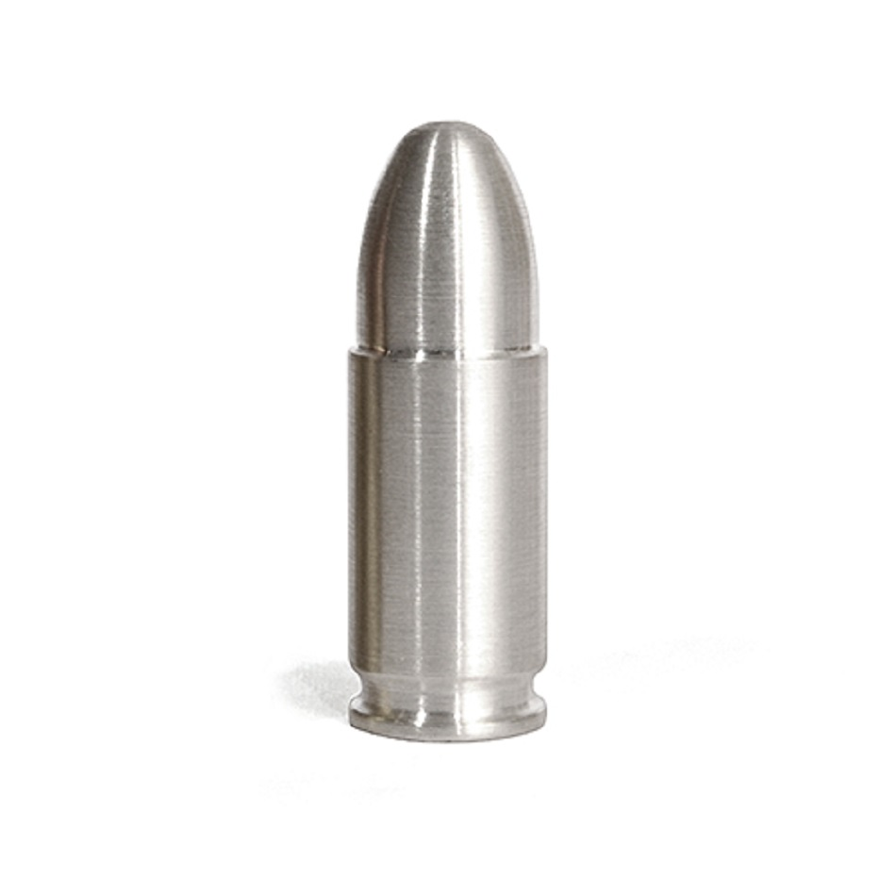

Slide 38
?

